Slide 2

Contact:
aryamankolhe@acm.org
chasmiccoder@gmail.com

Slide 3









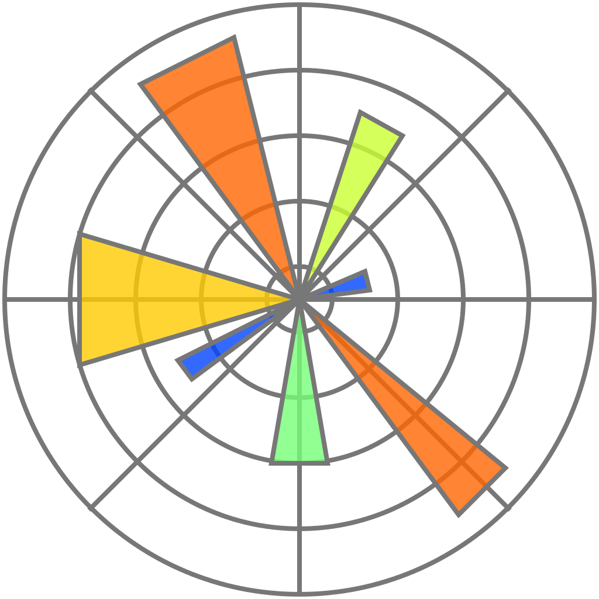






Tech Stack I’m familiar with:

Slide 4


